Slide 1
Project 2

Slide 2
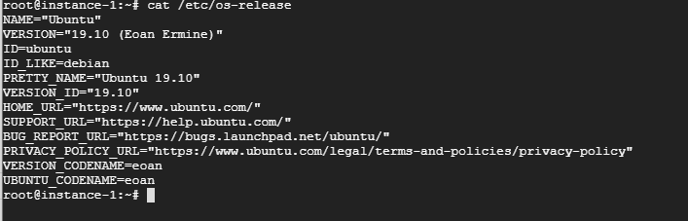
Start your Instance – For this exercise I chose Google Cloud Engine and made sure to select ‘Boot Disk’ Ubuntu 19

Slide 3
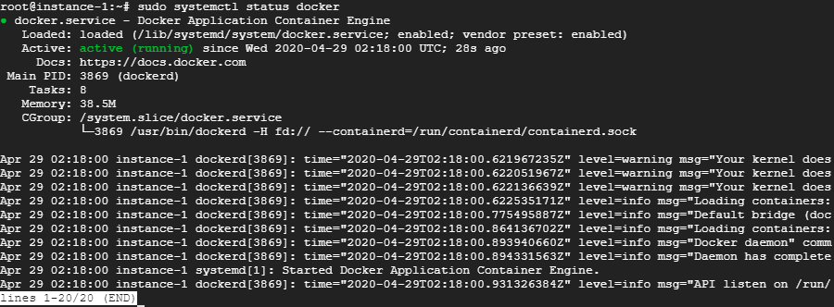
Step 1 Install Docker
Installation Guide to installing Docker on Ubuntu
https://www.cloudbooklet.com/set-up-docker-on-ubuntu-18-04-lts/

Slide 4
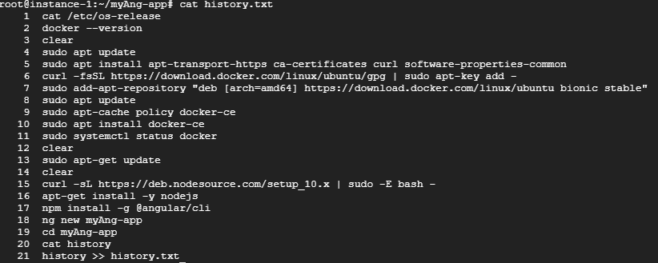
Install Angular app on Ubuntu
15. This appears to download a node package installer pointing towards nodejs 10
16. Install NodeJS
17. Install Angular JS – I chose CSS styling
18. Create a directory for your Angular app
19. Navigate into your Angular app

Slide 5
Install Angular app on Ubuntu
15. This appears to download a node package installer pointing towards nodejs 10
16. Install NodeJS
17. Install Angular JS – I chose CSS styling
18. Create a directory for your Angular app
19. Navigate into your Angular app

Slide 6
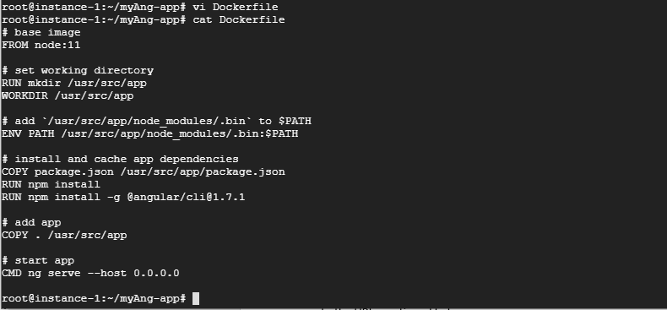
This is your Docker container configuration. Once it gets built it can be re run ??? WHy
Use vi to create and edit your Dockerfile
Using Node 11 as our base image, adding a directory for our app and setting it as our work directory.
Add node_modules to our $PATH as ENV variable and copy package config to the work directory.
Install node modules and angular
Copy everything at root path to working directory
Start the Angular app

Slide 7
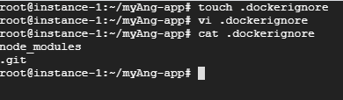
This is your Docker container configuration. Once it gets built it can be re run ??? WHy
Create a .dockerignore files and add node_modules and .git

Slide 8
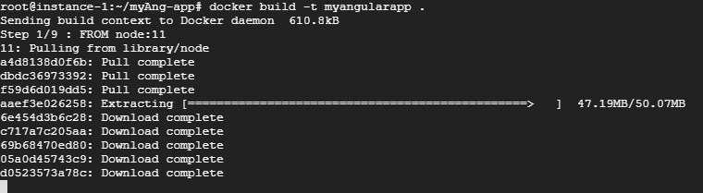
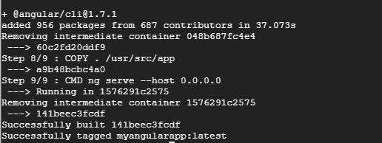
Build our Docker Image
Running Docker Build –t myangularapp .
Docker executes all the commands in our Dockerfile and builds our image.
The first step entails pulling an image from a remote repository, in the screencap on the left, we can see the container being pulled.

Slide 9
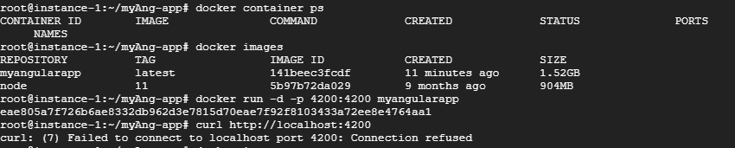
We attempt to run our container, but it fails

Slide 10
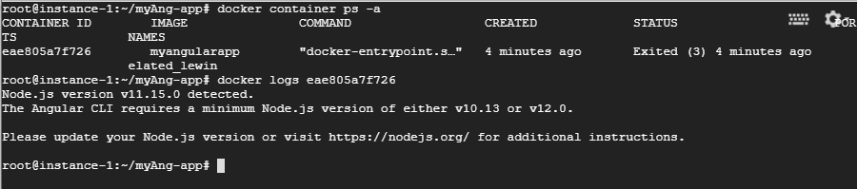
It seems we need to upgrade our version of Node js

Slide 11
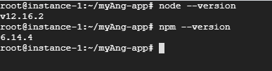
Updates successful
Instructions found here
https://computingforgeeks.com/how-to-install-nodejs-on-ubuntu-debian-linux-mint/

Slide 12
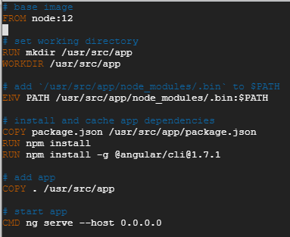
Mistake!
The previous step was useless because we needed to upgrade Node JS within the container itself.
Update the base image in the Dockerfile

Slide 13
Mistake!
The previous step was useless because we needed to upgrade Node JS within the container itself.
Update the base image in the Dockerfile

Slide 14
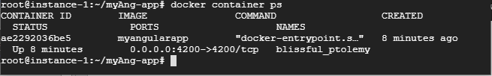
Now when we run Docker ps (process status) we see our container running at port 4200

Slide 15
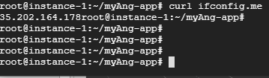
Run ifconfig.me to get our ip address

Slide 16
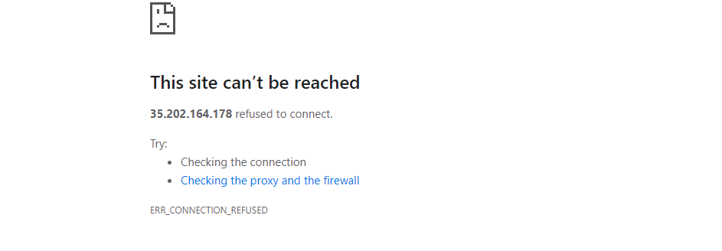
I want to check if my app is running in the browser so I navigate to 35.202.164.178:4200 from my local computer. The page hangs, so I probably need to open up HTTP access into my google cloud instance.

Slide 17
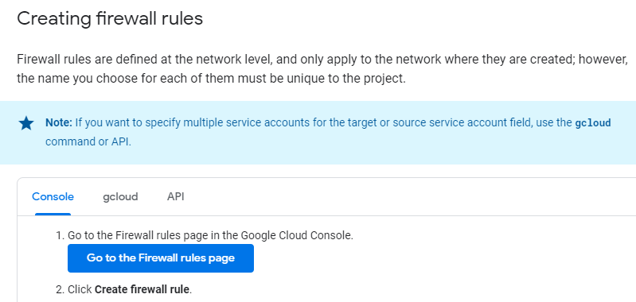
I followed instructions at this link to adjust the firewall settings of my Google Cloud Instance https://cloud.google.com/vpc/docs/using-firewalls#console

Slide 18
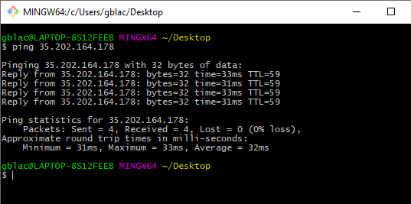
Now I ping my cloud ip from my local and it seems to be working

Slide 19
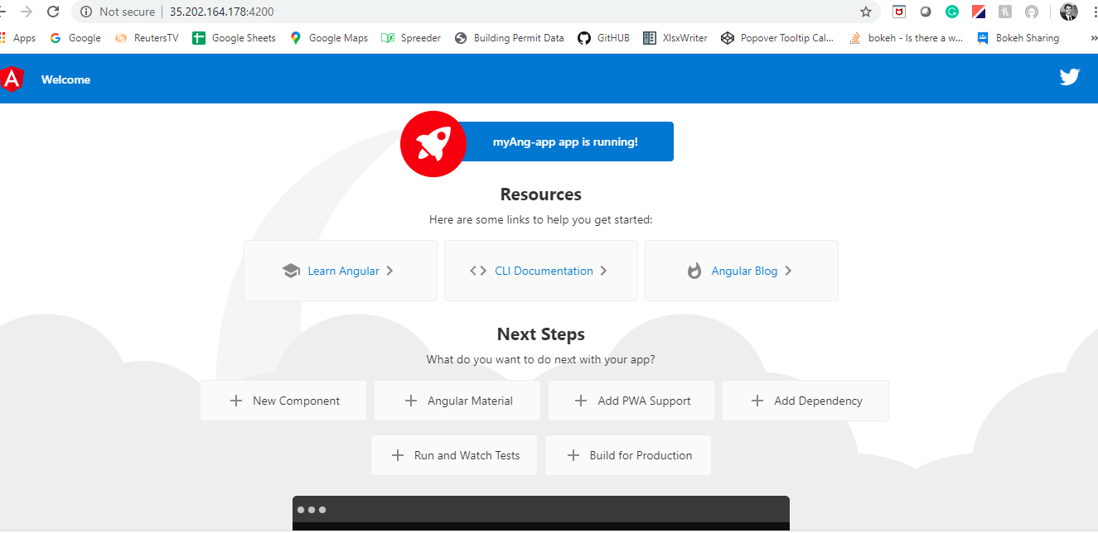
Finally! The app has been deployed and I can start to access it from my local computer.

